Slide 1


Josiah Nyongesa
February 17, 2025

Slide 2

Outline
Executive Summary
Introduction
Methodology
Results
Conclusion
Appendix

Slide 3
Executive Summary
Summary of methodologies
Data Collection
Data Wrangling
EDA with Data Visualization
EDA with SQL
Interactive Visualization with Folium
Dashboard with Plotly Dash
Predictive analysis using classification models
Summary of all results
EDA Results
Interactive Analytics
Predictive Analysis

Slide 4
Introduction
The space industry is evolving rapidly, with SpaceX leading the way in reducing launch costs through reusable rocket technology. As a new competitor, SpaceY aims to optimize its rocket landings using data science. This project applies machine learning and predictive analytics to analyze past launches, identify key success factors, and develop models to improve booster recovery rates.
Business Problem
Rocket reusability is key to lowering launch costs. While SpaceX has cut costs from $150M to $62M per launch, not all boosters are recoverable due to payload weight, orbit type, and landing conditions. To compete, SpaceY must predict booster landings accurately. This project develops a predictive model to enhance cost efficiency and mission success, positioning SpaceY as a strong industry contender.

Slide 5

Section 1

Slide 6
Methodology
Executive Summary
Data collection methodology:
Data was collected using web scraping.
Perform data wrangling
Exploratory Data Analysis to find some patterns in the data and determine what would be the label for training supervised models.
Perform exploratory data analysis (EDA) using visualization and SQL
Exploratory Data Analysis using python library (Matplotlib, Seaborn) and using SQL , Feature Engineering
Perform interactive visual analytics using Folium and Plotly Dash
Use Folium to view previously observed correlations
Perform predictive analysis using classification models
Create a machine learning pipeline to predict if the first stage will land given the data from the preceding observations

Slide 7
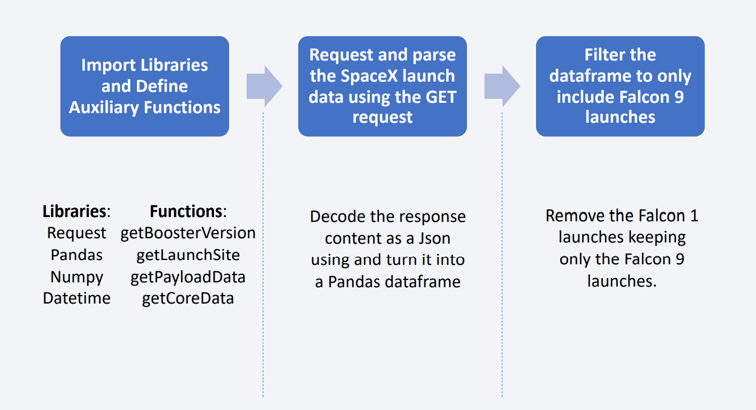
Data Collection

Slide 8
Data Collection – SpaceX API
Request rocket launch data from SpaceX API using URL
Decode the response content as a Json using and convert it into a pandas dataframe
Fixed information in correct columns (using previously defined functions)
Construct dataset using the data we have obtained
GITHUB URL : Data Collection

Slide 9
Data Collection - Scraping
Request the Falcon9 Launch Wiki page from its URL
Extract all column/variable names from the HTML table header
Create a data frame by parsing the launch HTML tables
GITHUB URL : Data Collection

Slide 10
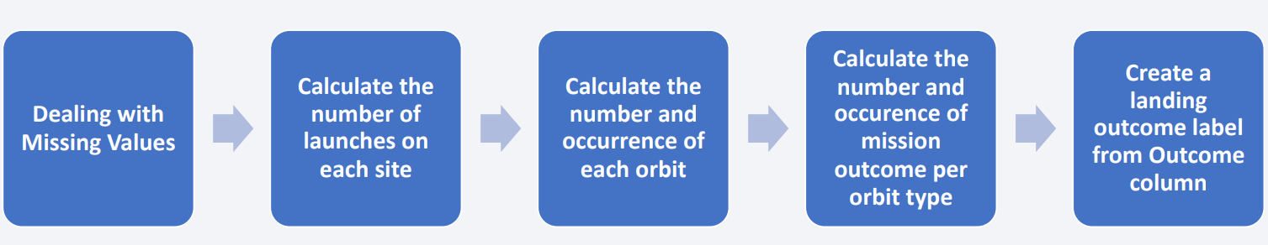
Data Wrangling
GITHUB URL:Data Wrangling

Slide 11
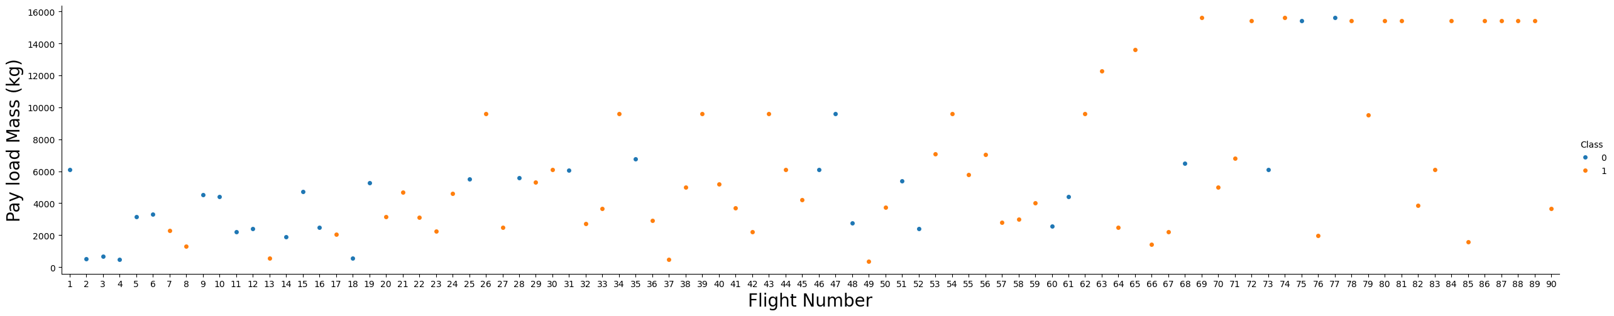
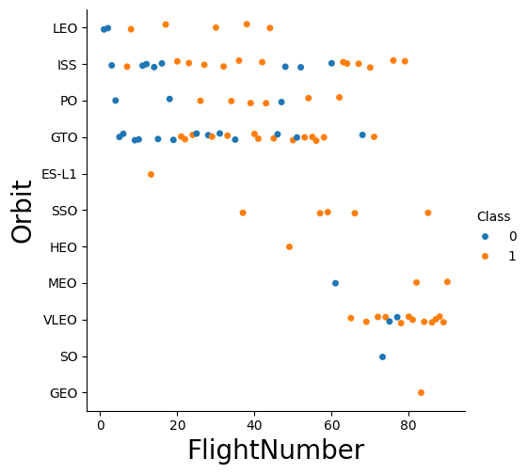
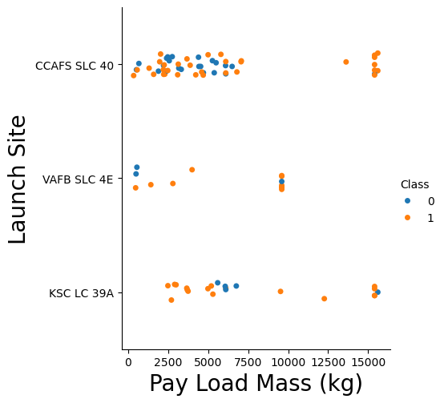
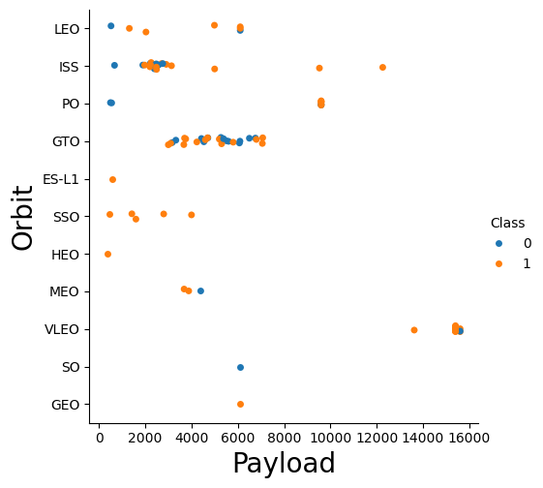
EDA with Data Visualization
Scatter point charts are used to visualize the relationship between (1) Flight Number and Launch Site, (2) Payload and Launch Site, (3) Flight Number and Orbit type, (4) Payload and Orbit type.
GITHUB URL: EDA Data Viz

Slide 12
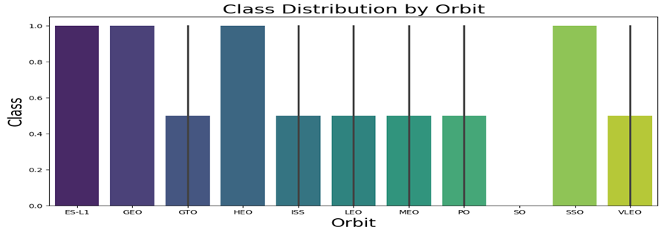
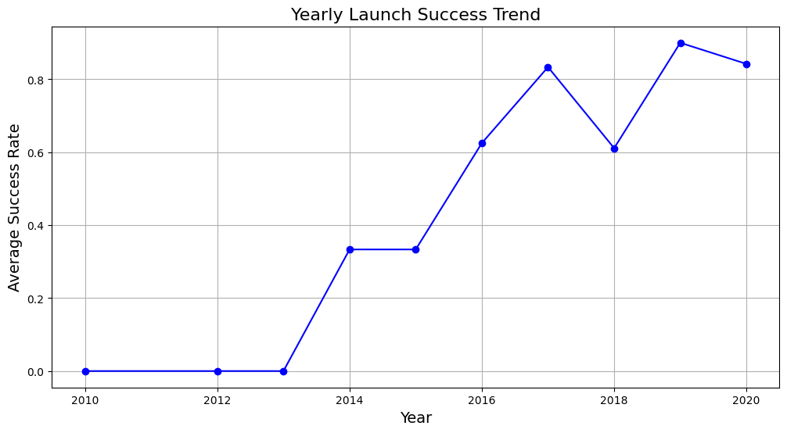
EDA Viz Cont’d
Bar chart was used to visualize the relationship between success rate of each orbit type; Line chart was used to visualize the launch success yearly trend.
GITHUB URL: EDA Data Viz

Slide 13
EDA with SQL
SQL queries performed
1.Display the names of the unique launch sites in the space mission
2. Display 5 records where launch sites begin with the string 'CCA’
3. Display the total payload mass carried by boosters launched by NASA (CRS)
4. Display average payload mass carried by booster version F9 v1.1
5. List the date when the first successful landing outcome in ground pad was achieved.
6. List the names of the boosters which have success in drone ship and have payload mass greater than 4000 but less than 6000
7. List the total number of successful and failure mission outcomes
8. List the names of the booster versions which have carried the maximum payload mass using a subquery
9. List the records which will display the month names, failure landing outcomes in drone ship ,booster versions, launch site for the months in year 2015.
10. Rank the count of landing outcomes (such as Failure (drone ship) or Success (ground pad)) between the date 2010-06-04 and 2017-03-20, in descending order.
GITHUB URL: EDA Data Viz

Slide 14
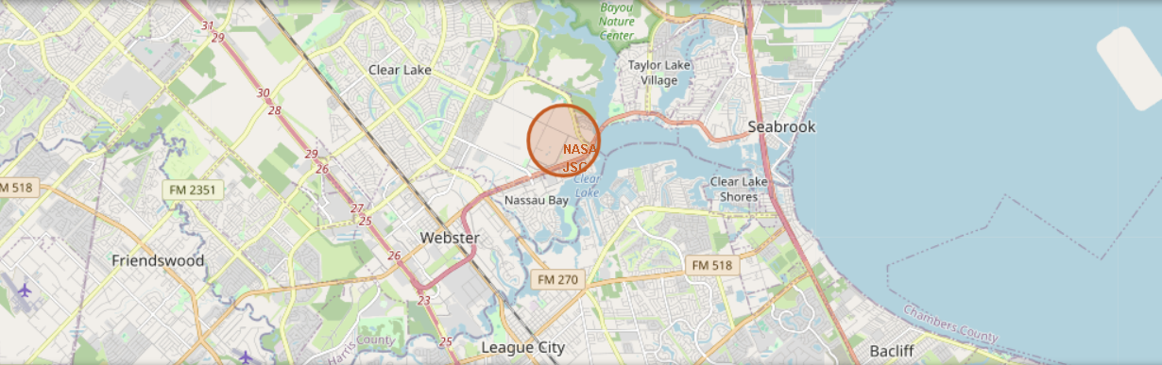
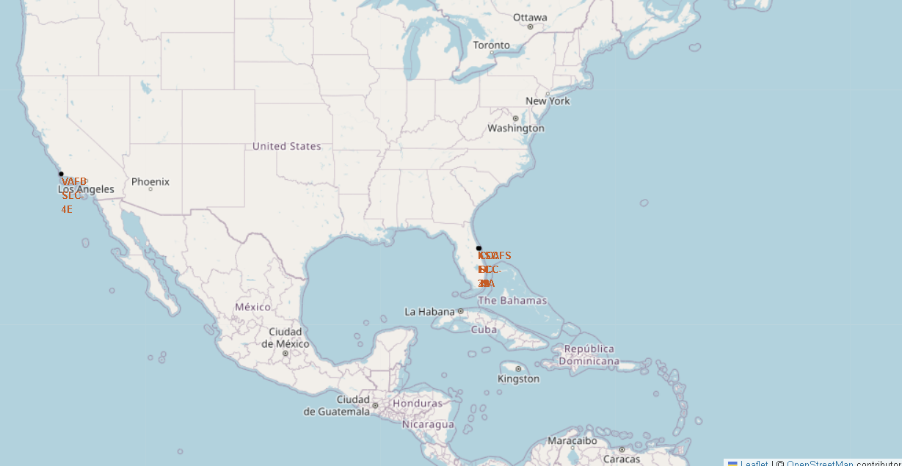
Build an Interactive Map with Folium
A circle marker was created to show NASA Johnson Space Center's coordinate.
Distance marker was created to show distances between a launch site to its proximities.
GITHUB URL: Launch site map Visuals

Slide 15
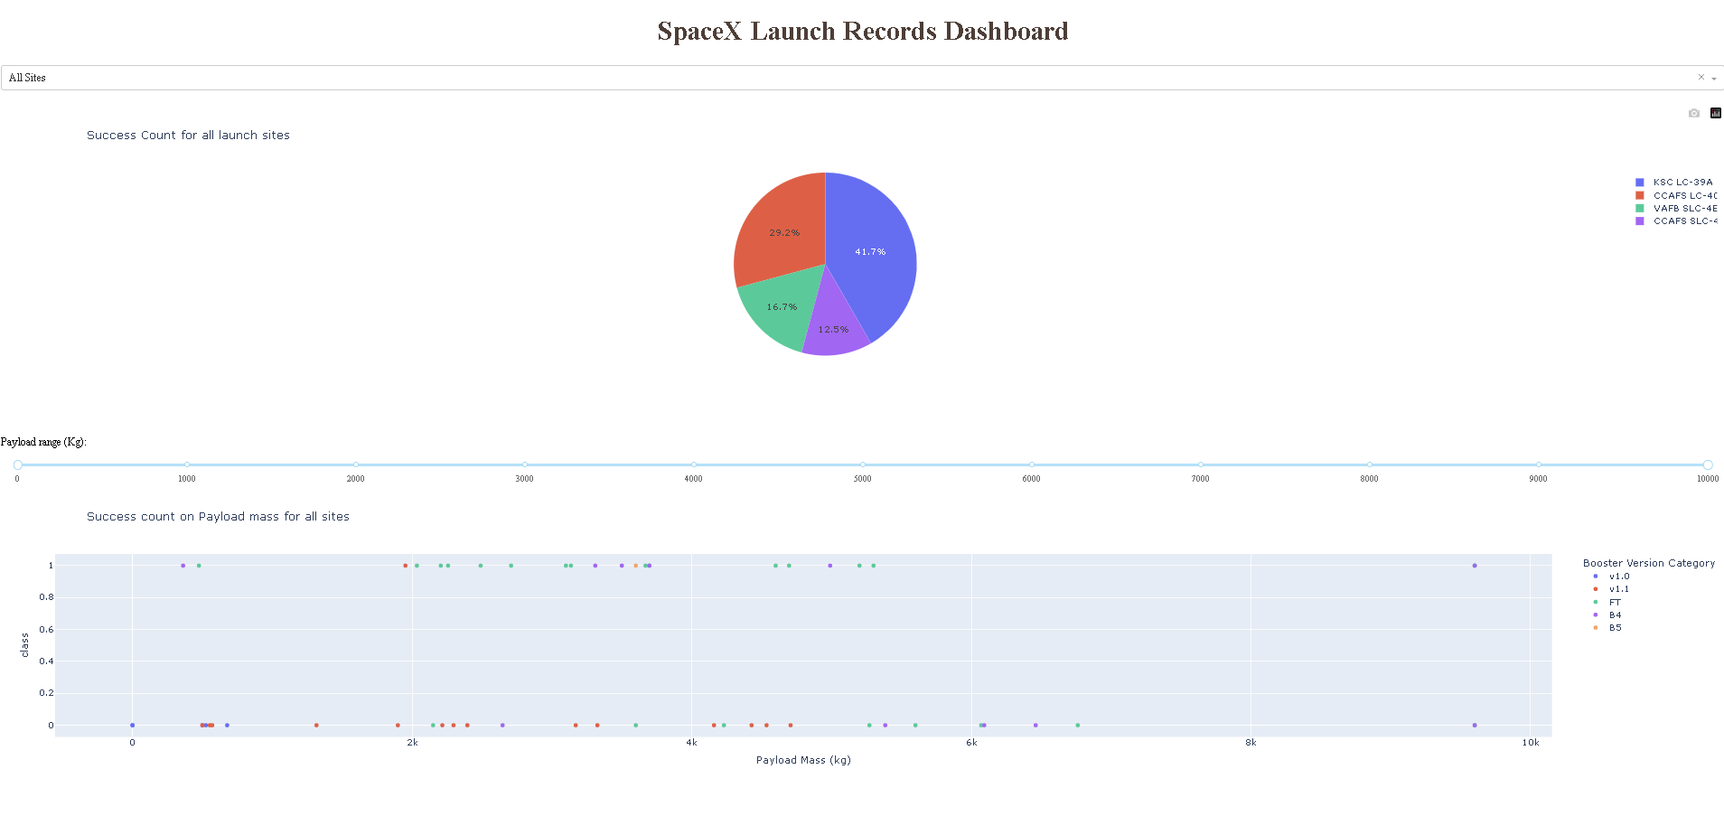
Build a Dashboard with Plotly Dash
Dropdown option of pie chart created to show the success launches of all / each site
Scatter plot with payload range slider to show the success launches of all / each site by payload mass
GitHub URL: SpaceX Launch Records Dashboard

Slide 16
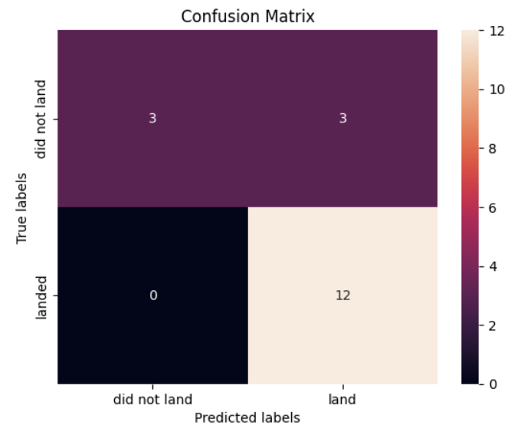
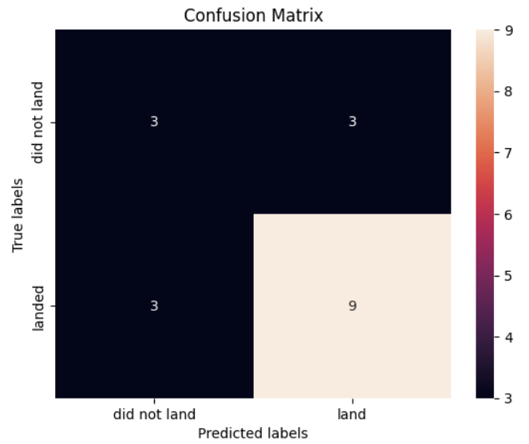
Predictive Analysis (Classification)
LR, SVM, Decision Tree and KNN models were trained using GridSearchCV to optimize parameters before fitting them on a training set. The confusion matrices for LR, SVM and KNN were identical, while the Decision Tree showed variance.
Model accuracy on test data was evaluated, revealing that LR, SVM and KNN performed best each achieving 83.33% accuracy, whereas the Decision Tree had a lower accuracy of 66.67%.
GITHUB URL: ML prediction

Slide 17
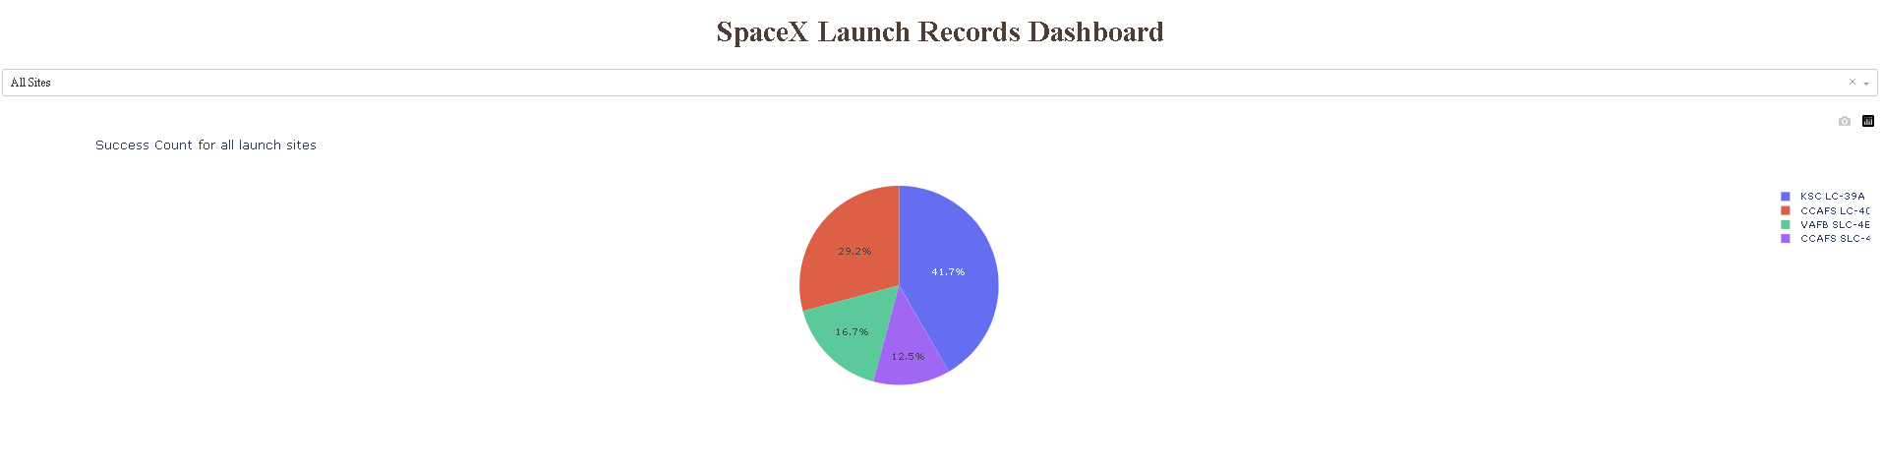
Results
• LR, SVM, KNN are top-performing models for forecasting outcomes in this data.
• Lighter payloads have a higher performance compared to heavier ones.
• The likelihood of a SpaceX launch succeeding increases with the number of years of experience, suggesting a trend towards flawless launches over time.
• Launch Complex 39A at Kennedy Space Center has the highest number of successful launches compared to other launch sites.
• GEO,HEO,SSO,ES L1 orbit types exhibit the highest rates of successful launches.
KSC LC-39A has the most successful launches overall

Slide 18

Section 2

Slide 19
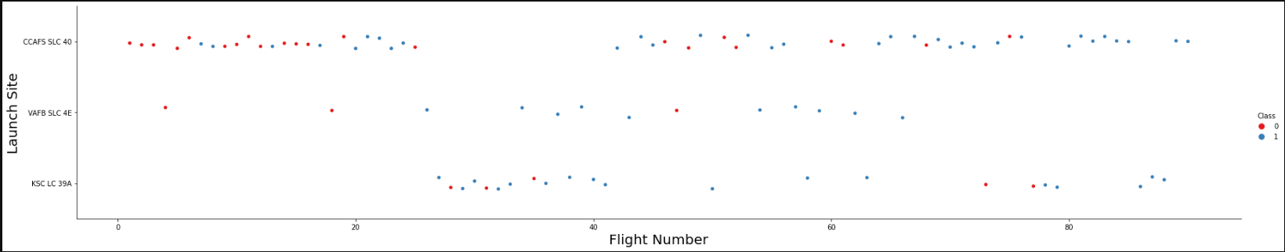
Flight Number vs. Launch Site
For the CCFS SLC 40 category there seems to be a higher concentration than class 1 for flights with Flight Number high.

Slide 20
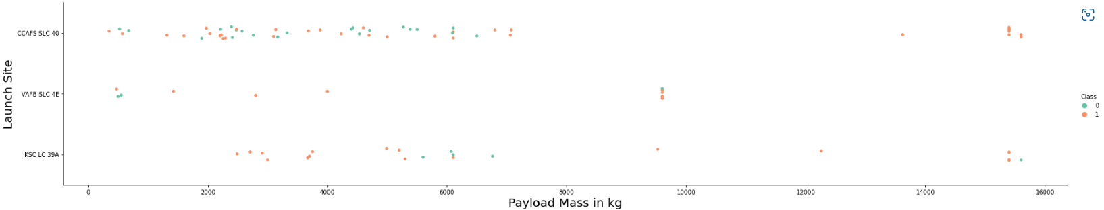
Payload vs. Launch Site
In this case there does not appear to be strong correlations

Slide 21

Success Rate vs. Orbit Type
We can see that the orbits with the highest success rate are:SSO, HEO, GEO, ES-L1
While the GTO Orbit it is the one with lowest rate

Slide 22
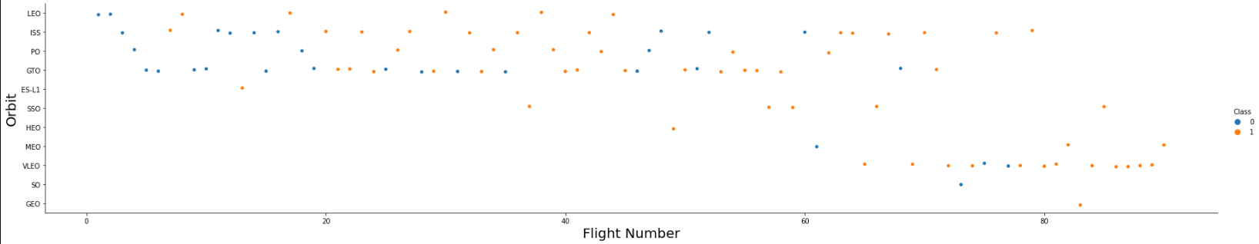
Flight Number vs. Orbit Type
You should see that in the LEO orbit the Success appears related to the number of flights; on the other hand , there seems to be no relationship between flight number when in GTO orbit.

Slide 23
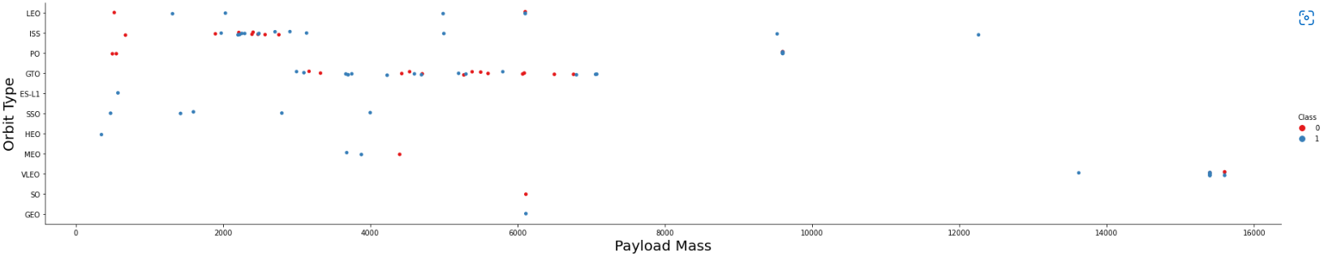
Payload vs. Orbit Type
You should observe that Heavy payloads have a negative influence on GTO orbits and positive on GTO and Polar LEO (ISS) orbits.

Slide 24
Launch Success Yearly Trend
You can see that the success rate since 2013 kept increasing till 2020.

Slide 25
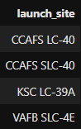
All Launch Site Names
This four launch sites are present in the database.

Slide 26
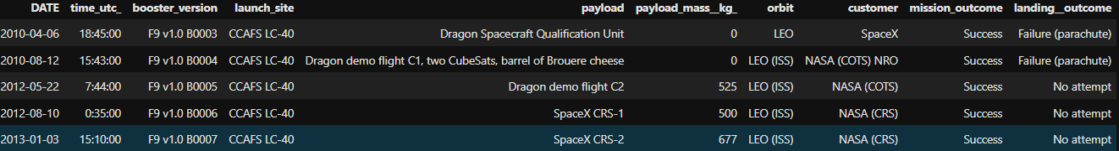
Launch Site Names Begin with 'CCA'
Records where launch sites begin with `CCA`

Slide 27
Total Payload Mass
The total payload carried by boosters from NASA is 45596.

Slide 28
Average Payload Mass by F9 v1.1
The average payload mass carried by booster version F9 v1.1 is 2928

Slide 29
First Successful Ground Landing Date
First successful landing outcome on ground pad is 2015-12-22

Slide 30
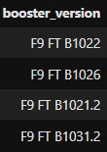
Successful Drone Ship Landing with Payload between 4000 and 6000
The names of boosters which have successfully landed on drone ship and had payload mass greater than 4000 but less than 6000

Slide 31
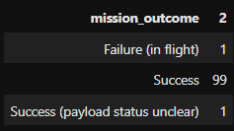
Total Number of Successful and Failure Mission Outcomes
The total number of successful and failure mission outcomes

Slide 32
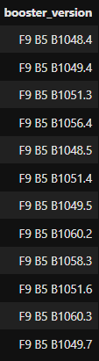
Boosters Carried Maximum Payload
This is the names of the booster which have carried the maximum payload mass

Slide 33
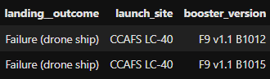
2015 Launch Records
There are two failed landing_outcomes in drone ship, in 2015, and they have the same launch site.

Slide 34
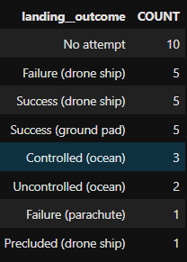
Rank Landing Outcomes Between 2010-06-04 and 2017-03-20
We can see that the most numerous are <<No attempt>>,followed by failure/success (drone ship)

Slide 35

Section 3

Slide 36
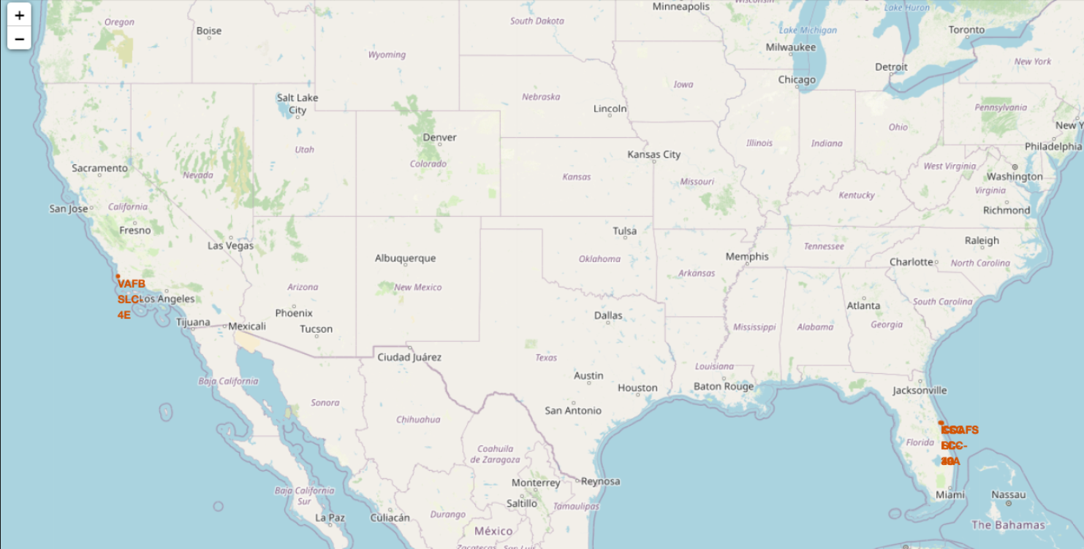
Launch Site
Both ground and sea surface sites are necessary also south areas maybe a proper areas.
The transportation base chosen maybe important

Slide 37
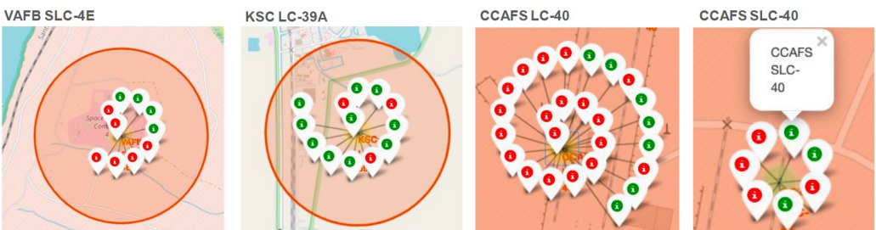
Success of launch
Color icons is impressive way to show the rate of success. For example, in KSC there is the best rate of success.

Slide 38
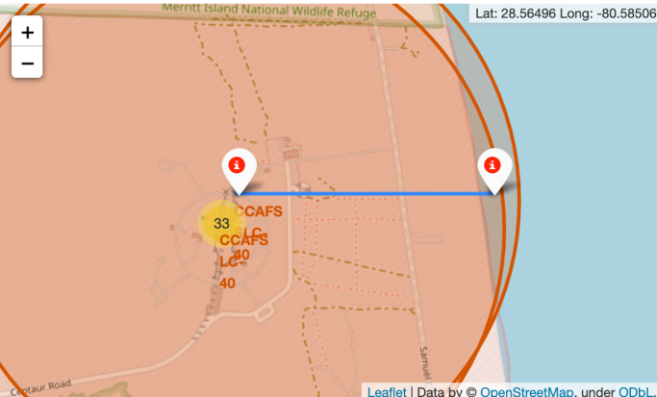
Distance
This map shows the distance from points of interest. In this case the distance from railway, coast or port may be importance.

Slide 39

Section 4

Slide 40
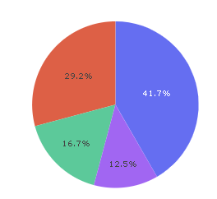
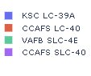
The most successful launch site
We can see that CCAFS SLC-40 had the most successful launches from all the sites.

Slide 41
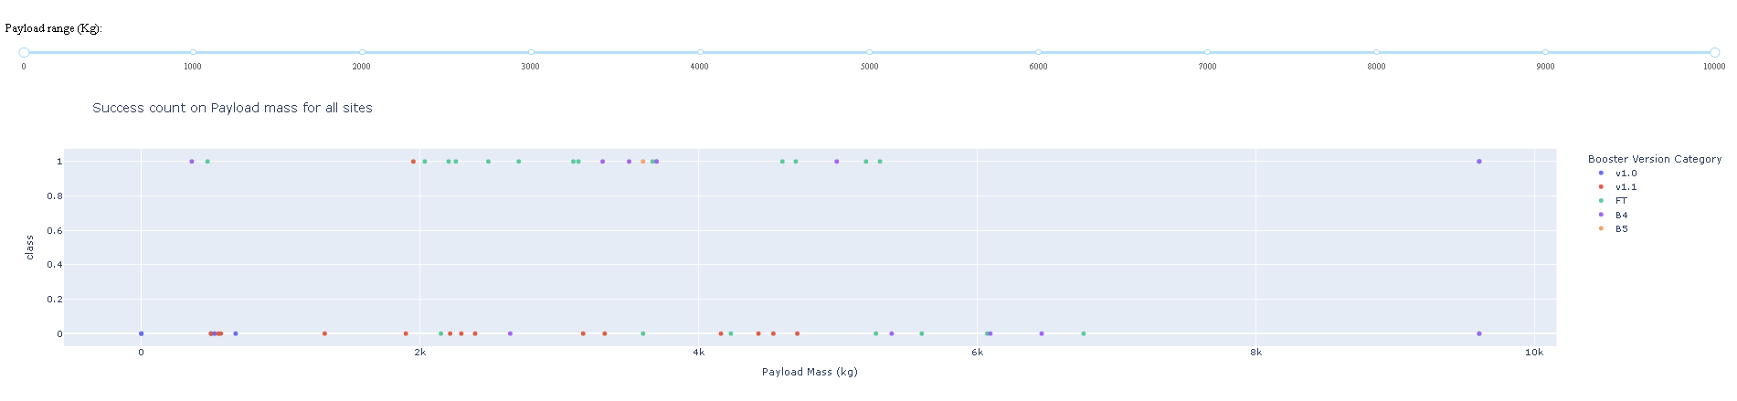
Payload and Success launch
• The payload range that has the highest success launches is between 2,000 to 4,000 kg, which can be seen by the most number of plots in that range, followed by the payload range of 4,000 to 6,000 kg, with the second most number of plots.
• Booster version FT (green spots) has the highest success launches, followed by B4 (purple spots) with the second highest success launches, among all booster versions.

Slide 42

Section 5

Slide 43
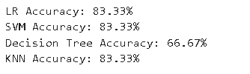
Classification Accuracy
Model accuracy on test data was evaluated, revealing that LR, SVM, and KNN performed best, each achieving 83.33% accuracy, whereas the Decision Tree had a lower accuracy of 66.67%.

Slide 44
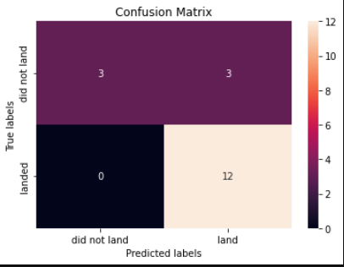
Confusion Matrix

Slide 45
Conclusions
This project demonstrates the power of data science and machine learning in optimizing rocket reusability. By analyzing past SpaceX launches, we developed predictive models to determine booster landing success, with Logistic Regression, SVM, and KNN achieving the highest accuracy (83.33%).
Takeaways include:
Lighter payloads have a higher success rate.
Launch success have improved over time
Certain orbit types(GEO, HEO, SSO, ES-L1) show higher landing success.
By leveraging these insights, SpaceY can enhance launch efficiency, minimize costs, and compete effectively in the commercial space industry. Future improvements could include incorporating real-time launch conditions and deep learning models for even more accurate predictions.
.

Slide 46
Appendix
GitHub link to all the codes, queries and images used. Click here

Slide 47


